Slide 1

Economic Outlook
Jonathan A. Neuberger
Economists Incorporated
October 2, 2013

Slide 2
Understanding where a country is going can depend in large part in understanding where it has been. This presentation on the outlook for the US economy examines key growth factors and extensive empirical data on short-term growth dynamics.

Slide 3
2013 GDP Data is Promising, Yet...

Slide 5
…Growth is Slowly Rising in Personal Consumption Expenditures

Slide 7
Goods Are Strongest Portion of Personal Consumption Expenditures

Slide 9
Retail Sales Should be Slightly Higher at This Point

Slide 11
Growth is Resurgent in Sales of Motor Vehicles and Parts, Yet…

Slide 13
…Even Higher Auto Sales are Required to Support Fundamentals

Slide 14
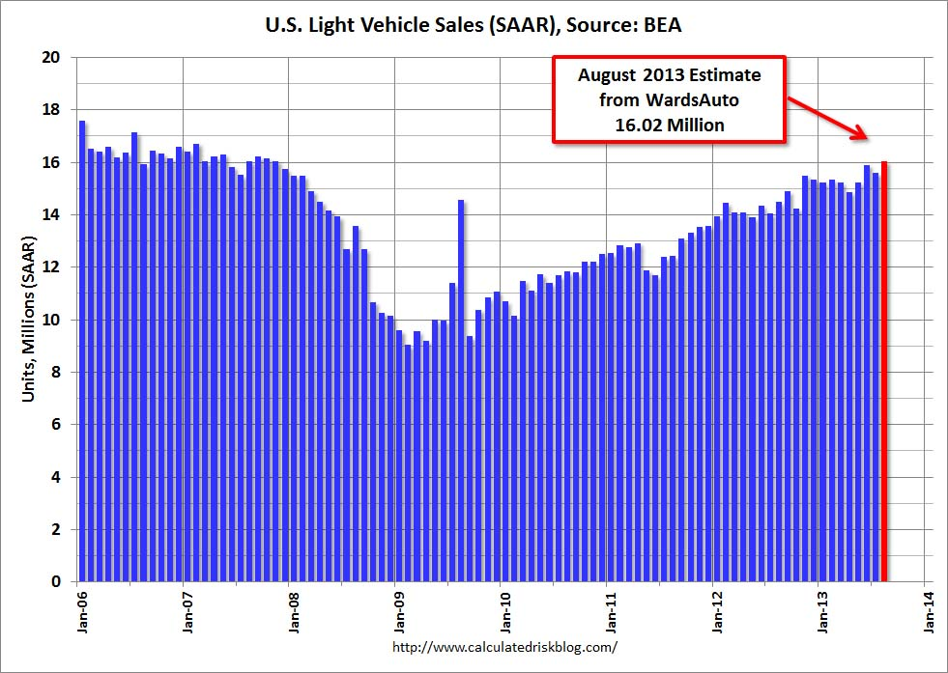

Slide 15
Spending Weakness is Due to Technical Factors

Slide 17
Housing Sector is the Key: Investment Belies Pent-up Demand

Slide 19
Construction Has Not Kept Pace with Demographics and Replacement Housing Activity

Slide 21
New Homes Sales Important and Positive Sign for Recovery

Slide 23
Increase in Mortgage Rates
Slowed Growth

Slide 25
Permits Data Point to Sustainable Housing Recovery

Slide 27
Surprisingly Rapid Rebound in Home Prices

Slide 29
Business Responds
After Housing Demand Increases

Slide 31
Government Spending and Shutdown Detracts from GDP

Slide 33
Unemployment Lags Fundamentals

Slide 35
Reconvergence of Replacement Housing Activity and Population Growth Requires 25% Construction Increase Over Four Years

